Slide 1
Facebook Integration on iOS
Phan Thanh Phat
Huynh Thanh Van

Slide 2
Topics covered
Facebook Integration
…
Graph API
Social Channels

Slide 3
Facebook Integration
Registering your iOS App with Facebook
Install Facebook SDK
Implement Single-Sign On
Using Facebook in our project.

Slide 4
Registering your iOS app with Facebook
https://developers.facebook.com/apps

Slide 5
Install Facebook SDK
Download Facebook iOS SDK: https://github.com/facebook/facebook-ios-sdk

Slide 6
Single Sign On
SSO lets users sign into your app using their Facebook identity.
SSO primarily works by redirecting users to the Facebook app on their devices. After authorization, users will be redirected to your mobile app with the appropriate access_token .

Slide 7
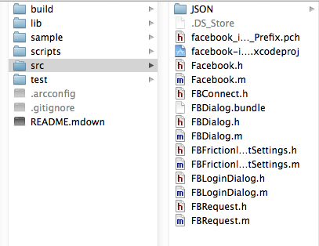
Integration Facebook iOS SDK
Projects don’t use arc → drag src folder to project folder.

Slide 8
Integration Facebook iOS SDK (cont.)
Projects do use ARC → Creating an iOS Facebook SDK Static Library
Run file build_facebook_ios_sdk_static_lib.sh under script directory:
% ~/facebook-ios-sdk/scripts/build_facebook_ios_sdk_static_lib.sh
If building successfully, it will create static library under lib folder

Slide 9
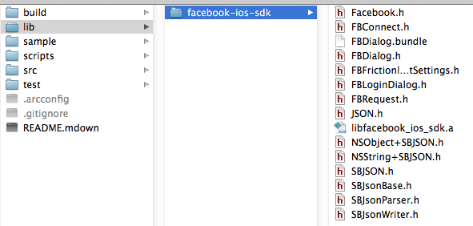
Integration Facebook iOS SDK (cont.)
drag the facebook-ios-sdk folder into the app Xcode project to include the iOS Facebook SDK static library.

Slide 10
Using Facebook in our project
In your App Delegate
#import "FBConnect.h”
@interface MyGreatIOSAppAppDelegate : NSObject <UIApplicationDelegate, FBSessionDelegate>
Declare instance variable: Facebook *facebook (used for invoking SSO, Graph API, Platform Dialogs ..)
Add lib Security.framework, QuartzCore.framework, SystemConfiguration.framework, CFNetwork.framework

Slide 11
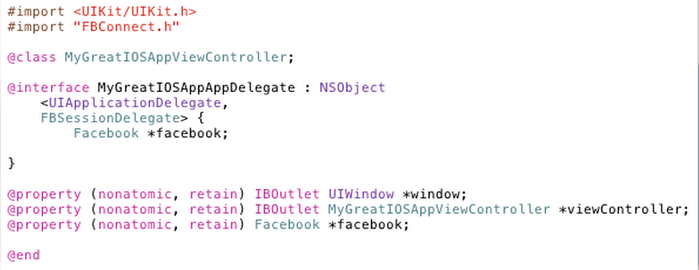

Slide 12
In App Delegate implementation file (.m):
Instantiate facebook variable:
facebook = [[Facebook alloc] initWithAppId:@"YOUR_APP_ID" andDelegate:self];
Set up valid session with Facebook by assigning access_token and expiration_date
Notes:
This ensures that your app does not redirect to the Facebook app and invoke the Auth Dialog if the app already has a valid access_token

Slide 13
Check session valid, if users don’t login or access_token expired, call authorize to ask users for login with permission

Slide 14
Handle

Slide 15
Archiving user access token to NSUserDefaults for later access → implement fbDidLogin (FBSessionDelegate)

Slide 16
Enable SSO in your app

Slide 17
Graph API
iOS SDK
PHP SDK
Graph API
Android SDK

Slide 18
Graph API…
https://www.facebook.com/dialog/oauth? client_id=YOUR_APP_ID
&redirect_uri=https://www.facebook.com/connect/login_success.html
&response_type=token
NSString *redirectUrlString = @"http://www.facebook.com/connect/login_success.html";
NSString *authFormatString = @https://graph.facebook.com/oauth/authorize?client_id=%@&redirect_uri=%@&scope=%@&type=user_agent&display=touch;
NSString *urlString = [NSString stringWithFormat:authFormatString, _apiKey, redirectUrlString, _requestedPermissions];// NSString *permissions = @"publish_stream";

Slide 19
Graph API…
At Facebook's core is the social graph; people and the connections they have to everything they care about.
Every object in the social graph has a unique ID. You can access the properties of an object by requesting https://graph.facebook.com/ID.
All of the objects in the Facebook social graph are connected to each other via relationships.
Friends: https://graph.facebook.com/me/friends?access_token=...
News feed (this is an outdated view, does not reflect the News Feed on facebook.com):https://graph.facebook.com/me/home?access_token=...
Profile feed (Wall): https://graph.facebook.com/me/feed?access_token=...

Slide 20
Graph API…
Likes: https://graph.facebook.com/me/likes?access_token=...
Movies: https://graph.facebook.com/me/movies?access_token=...
Music: https://graph.facebook.com/me/music?access_token=...
Books: https://graph.facebook.com/me/books?access_token=...
Notes: https://graph.facebook.com/me/notes?access_token=...
Permissions: https://graph.facebook.com/me/permissions?access_token=...
Photo Tags: https://graph.facebook.com/me/photos?access_token=...

Slide 21
Graph API…
Photo Albums: https://graph.facebook.com/me/albums?access_token=...
Video Tags: https://graph.facebook.com/me/videos?access_token=...
Video Uploads: https://graph.facebook.com/me/videos/uploaded?access_token=...
Events: https://graph.facebook.com/me/events?access_token=...
Groups: https://graph.facebook.com/me/groups?access_token=...
Checkins: https://graph.facebook.com/me/checkins?access_token=...
Objects with Location: https://graph.facebook.com/me/locations?access_token=...

Slide 22
Selection &&Pictures
You can choose the fields (or connections) you want returned with the "fields" query parameter. https://graph.facebook.com/bgolub?fields=id,name,picture
You can also request multiple objects in a single query using the "ids" query parameter. https://graph.facebook.com?ids=vfa.vanht, 100001829510111
The "ids" query parameter also accepts URLs. https://graph.facebook.com/?ids=http://www.imdb.com/title/tt0117500/
You can render the current profile photo for any object by adding the suffix /picture to the object URL. https://graph.facebook.com/100003710516180/picture

Slide 23
Paging
When querying connections, there are several useful parameters that enable you to filter and page through connection data:
limit, offset: https://graph.facebook.com/me/feed?limit=3
until, since : https://graph.facebook.com/search?until=yesterday&&q=banana

Slide 24
Reference
iOS Tutorial: https://developers.facebook.com/docs/mobile/ios/build/
Graph API https://developers.facebook.com/docs/reference/api/
Achievement(Instance) Album ApplicationCheckin Comment Domain Event FriendList Group Insights Link Message Note Offer Order Page Photo Post Question QuestionOption Review Status message Subscription Thread User Video

